Slide 1

Our Team
Mohamed Aboellil
Ziad Elsaid
Mohamed Adel
Aya Wael Mohamed

Slide 2


ZoneRave

Slide 3

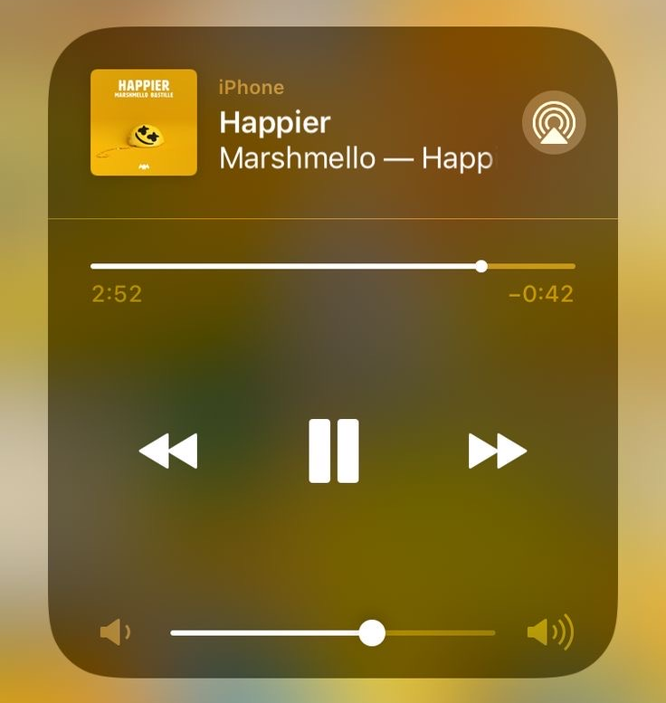
ZoneRave
Super App

Slide 4
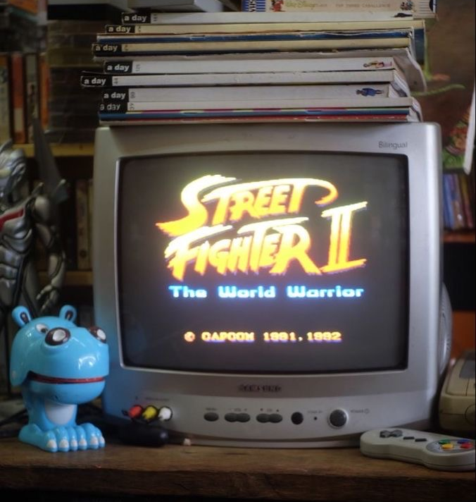
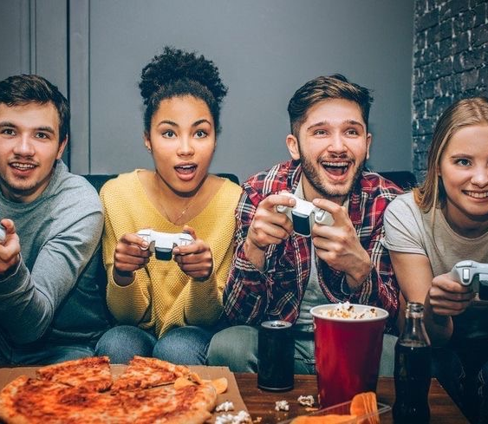
2
Into of our Super App
We will display package of some Movies with their Time raising …….
1
3
We will display package of some songs with their rating …….
We will display package of some Games …….

Slide 5
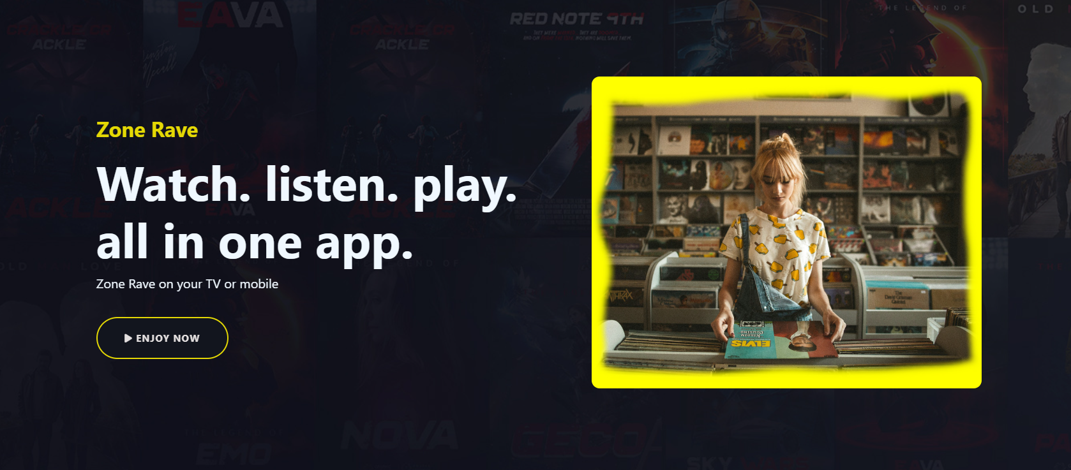

Slide 6
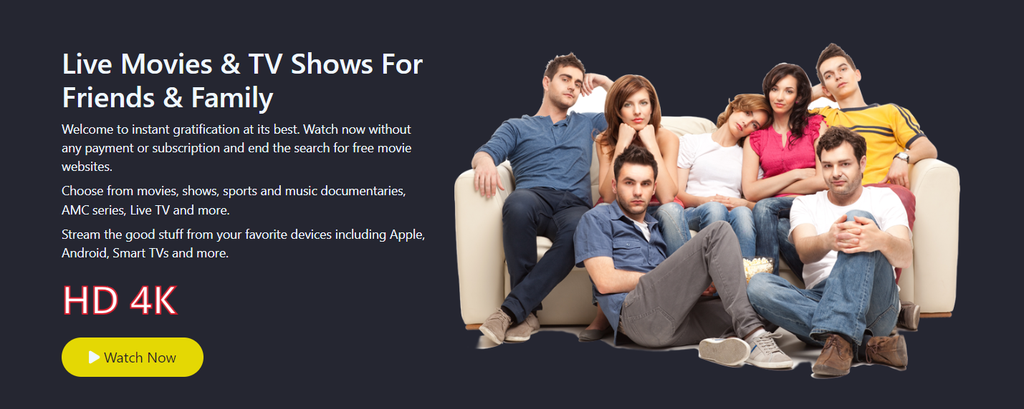

Slide 7
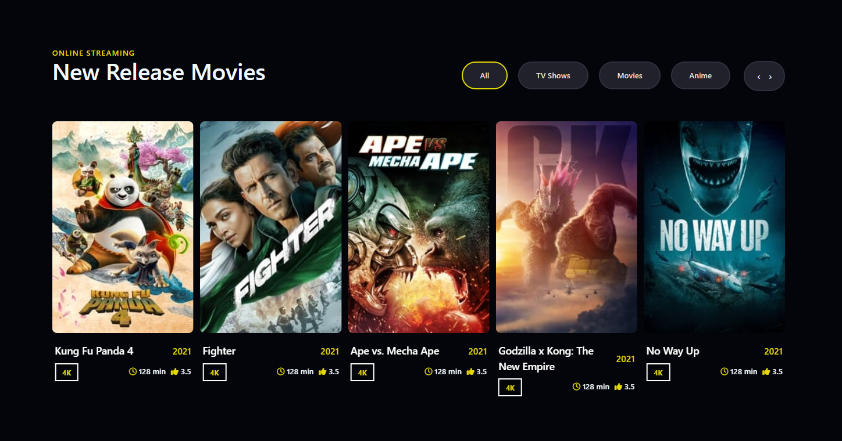

Slide 8
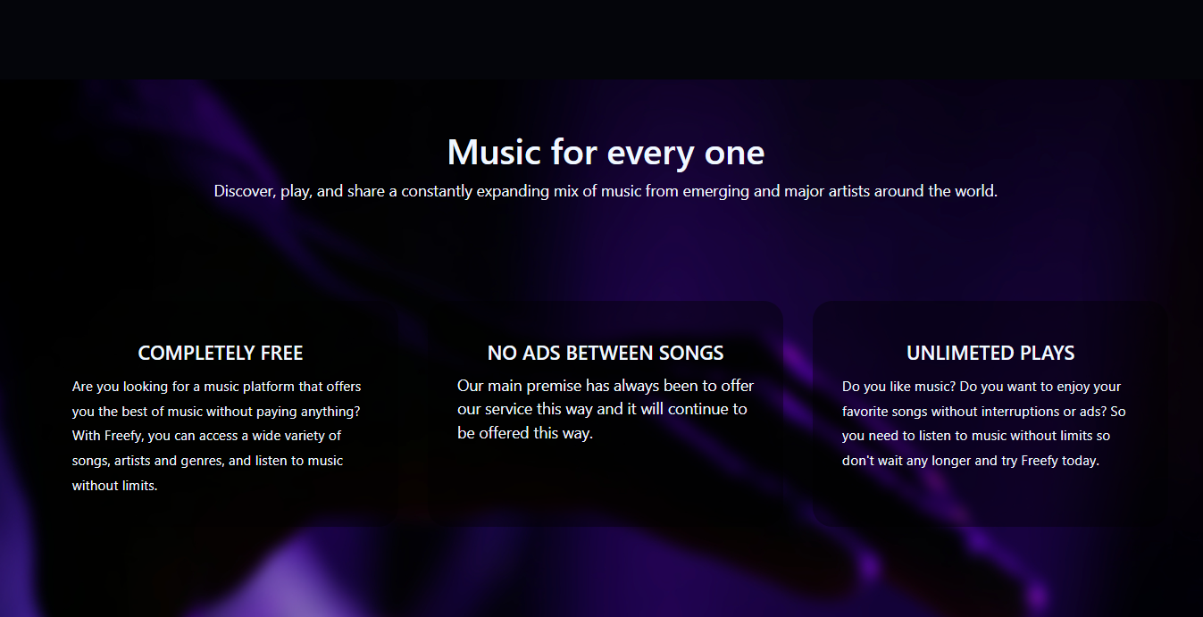

Slide 9
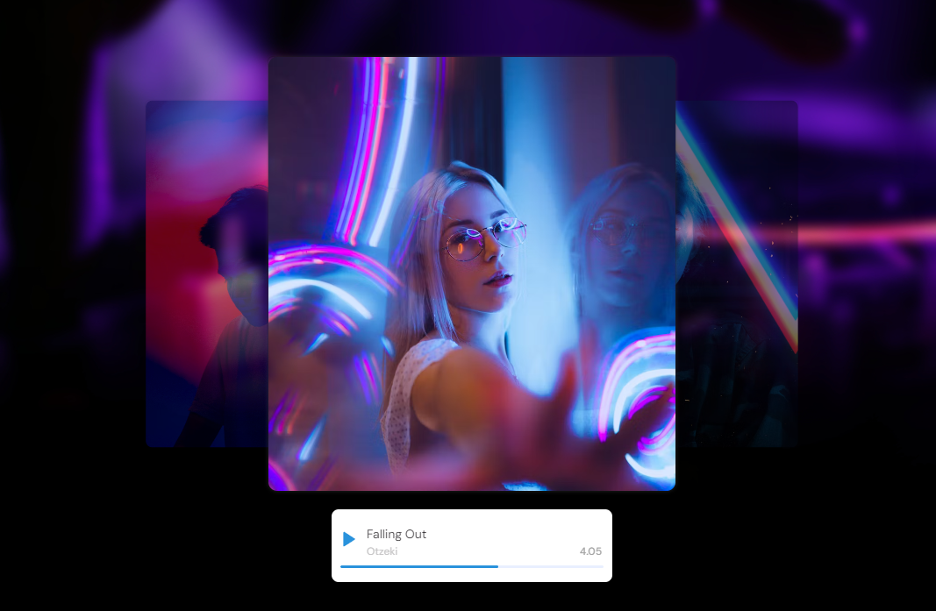

Slide 10
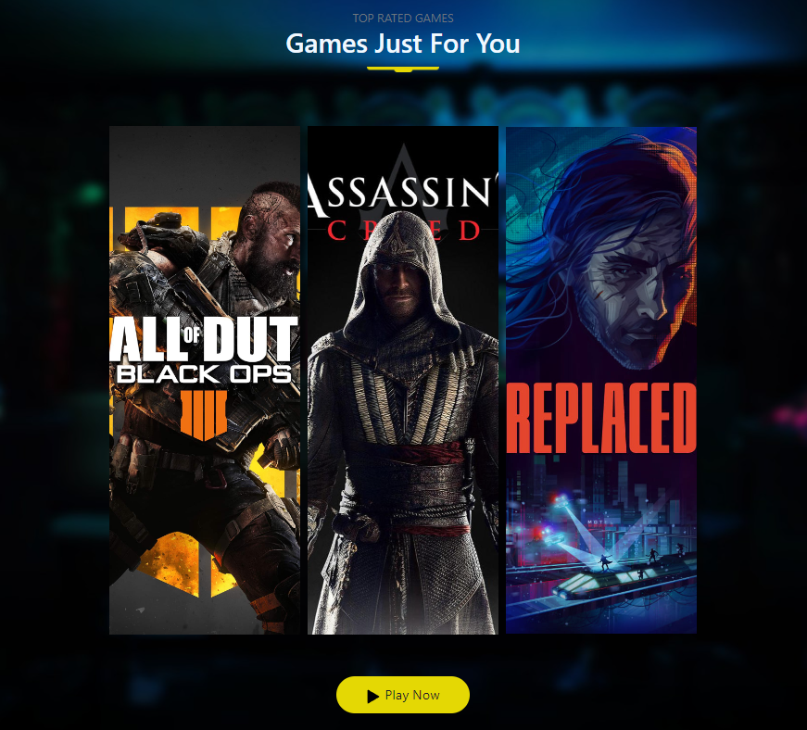

Slide 11


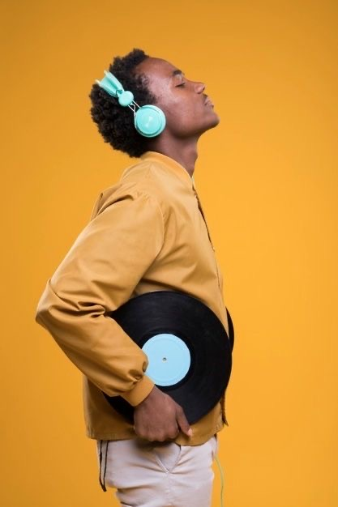
Games
Movies
Music

Slide 12
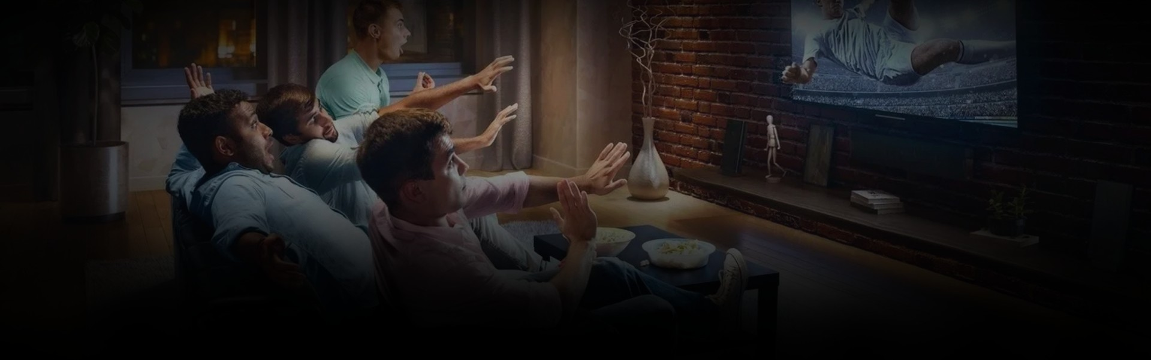
Movies
In this page of website , we display and Fetch in the background data about some trendy movies of the box office ….
We use in this page :

Slide 13
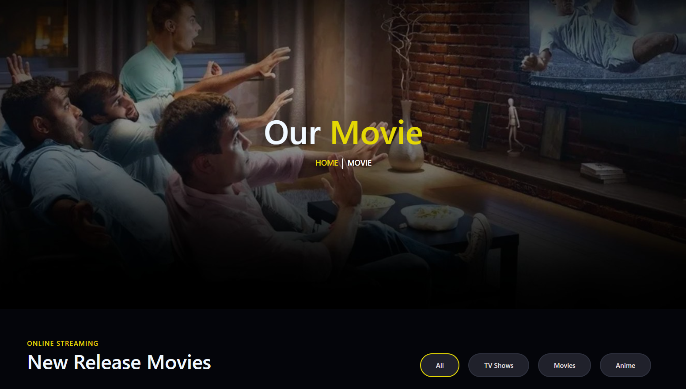

Slide 14
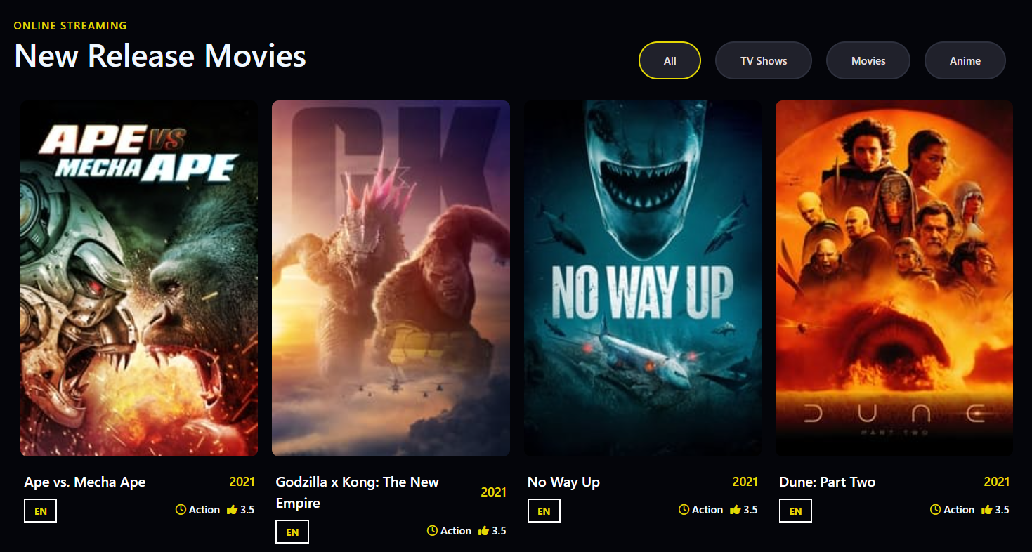

Slide 15
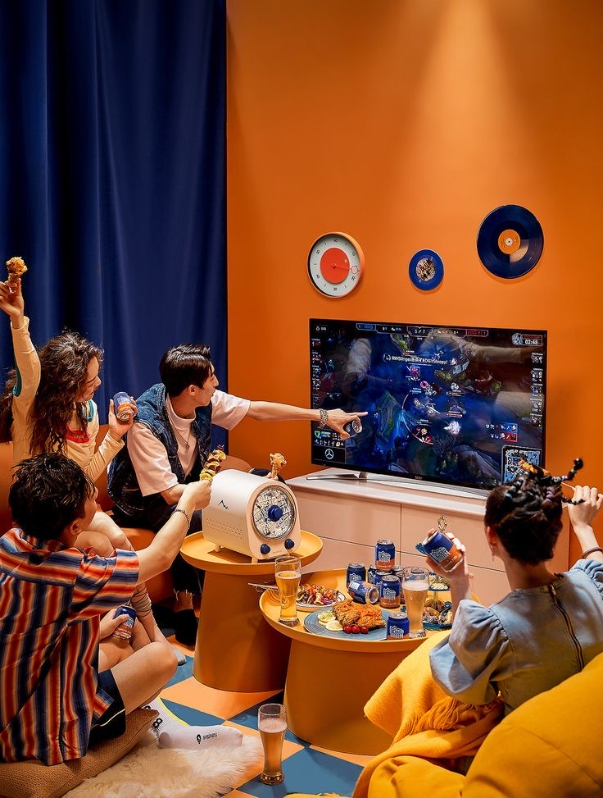
Games
In this page of website , we display and Fetch in the background data abut some popular games ….
We use in this page :

Slide 16
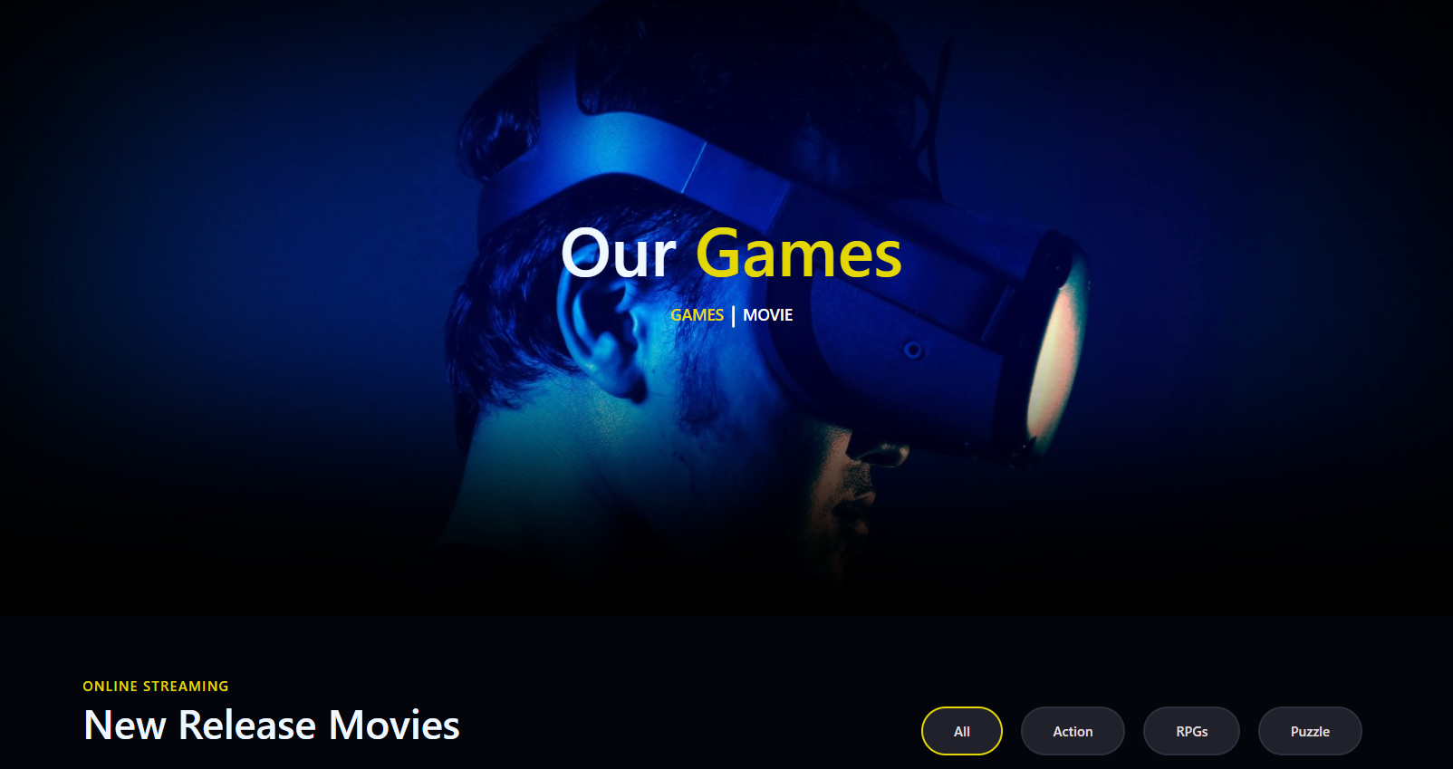

Slide 17
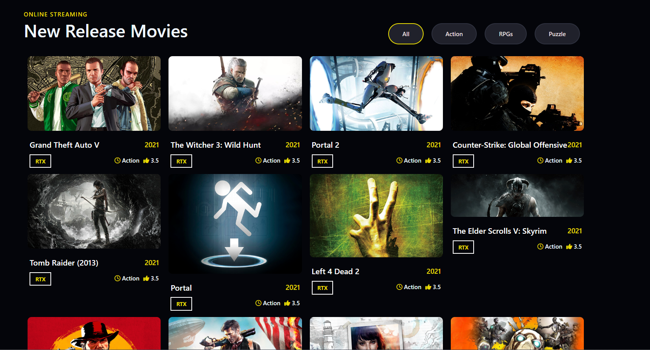

Slide 18
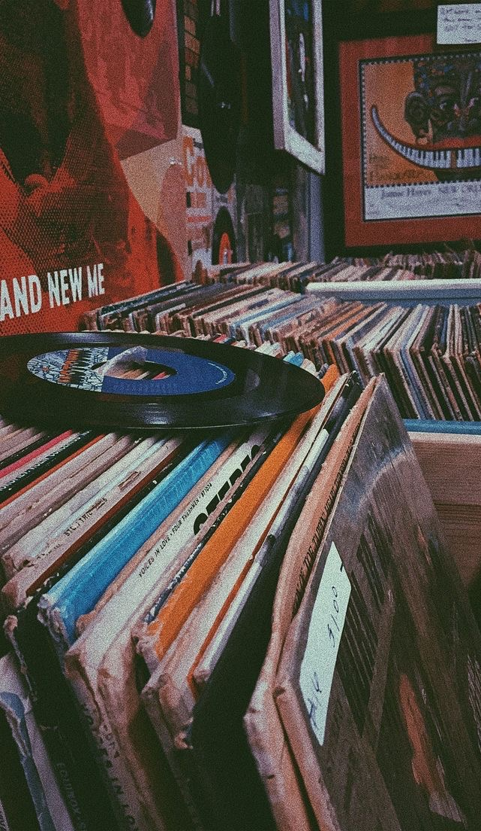
Music
In this page of website , we display and Fetch in the background data abut some trendy songs ….
We use in this page :

Slide 19
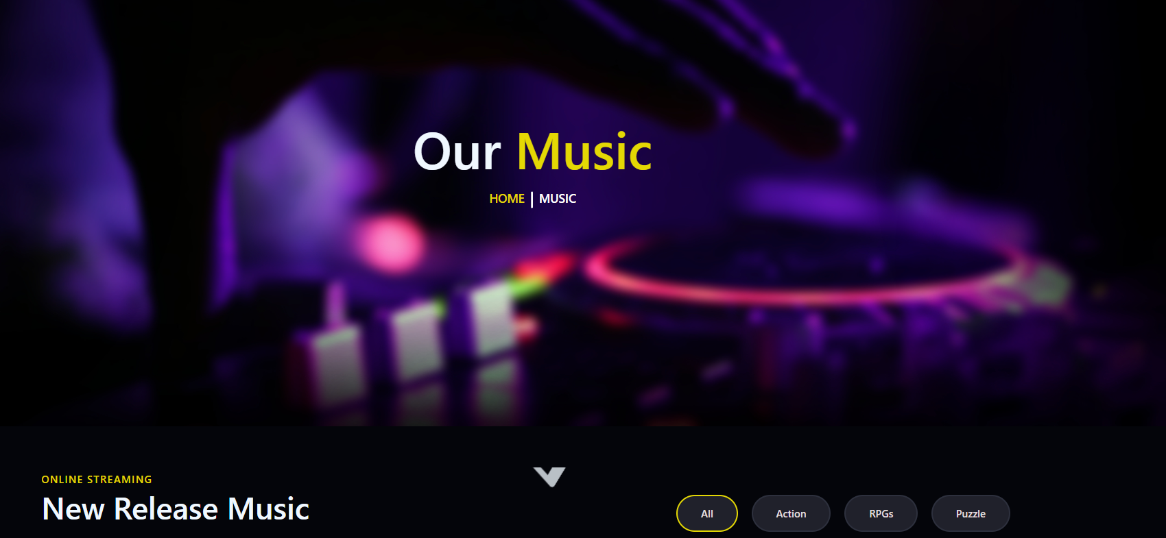

Slide 20
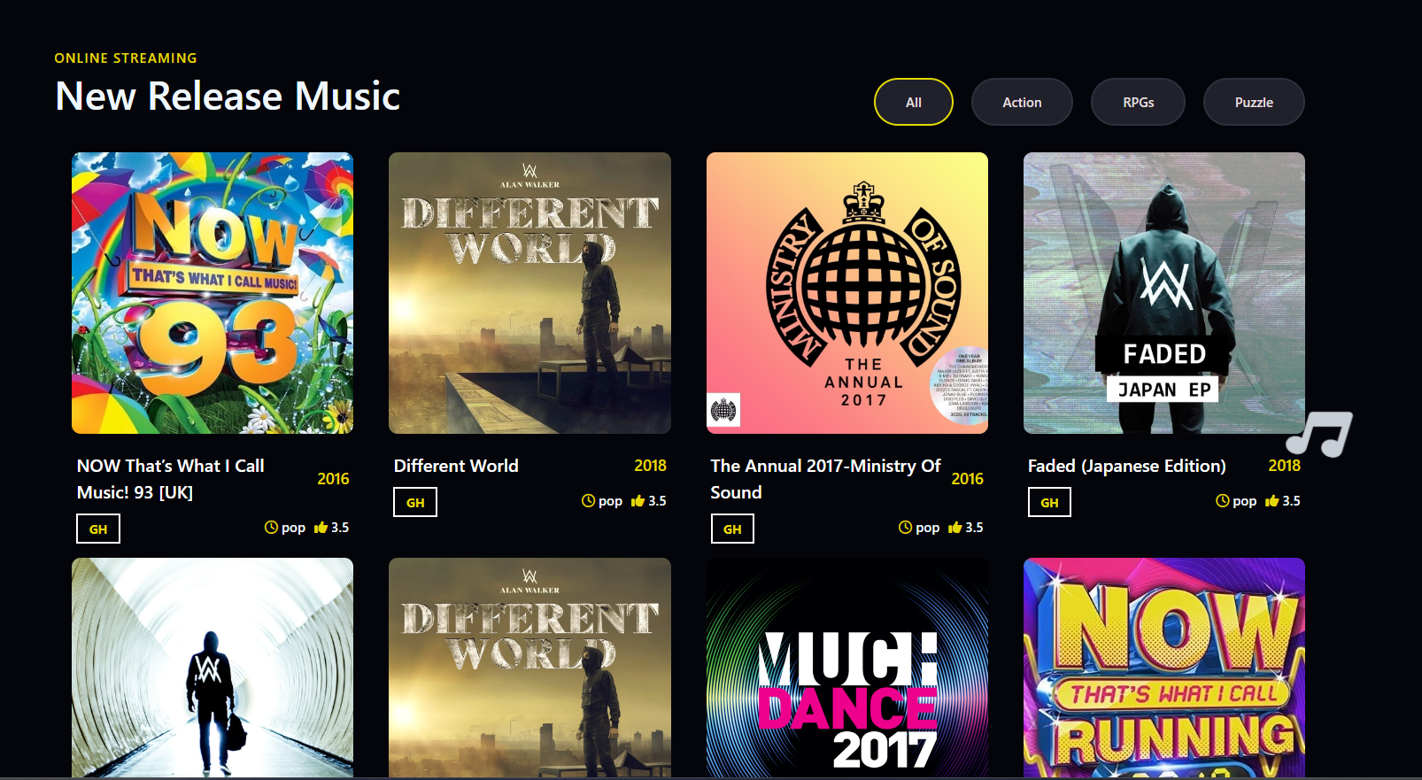

Slide 21

1
Bootstrap, sass
2
Open Source API
About Tools
3
Font awesome
4
Owl carousel
5
jQuery

Slide 22
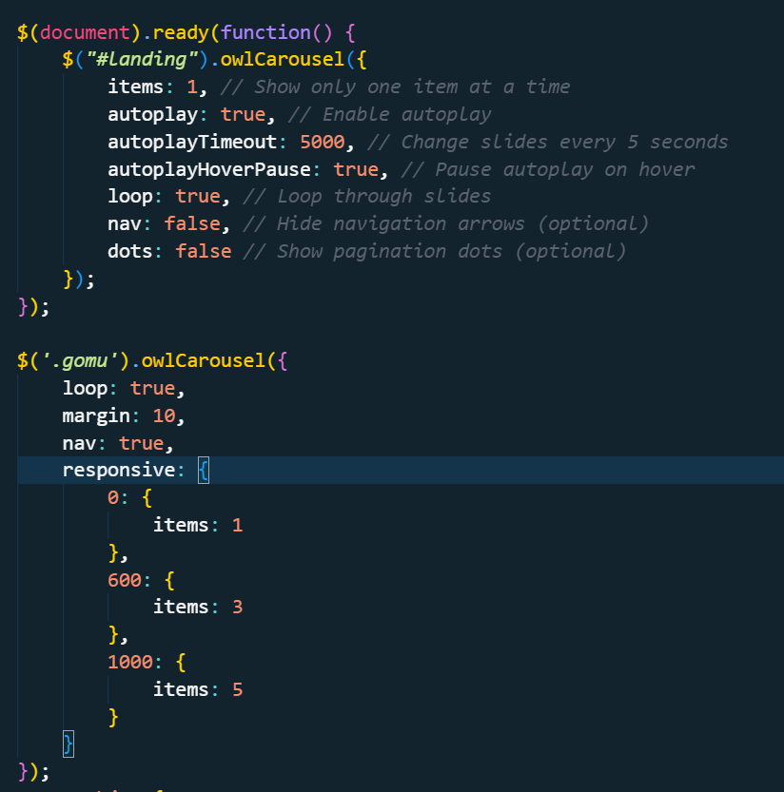

Slide 23
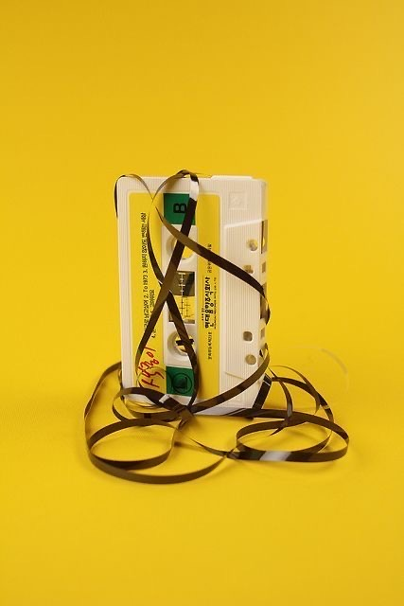
End Of Our Rave…….
Thanks

